Slide 1
A Quick and Easy Guide to Hosting React on AWS
Presented by: Christina Nguyen, Sarah Ramazani, Michael Bloomquist, Travis Lamb

Slide 2
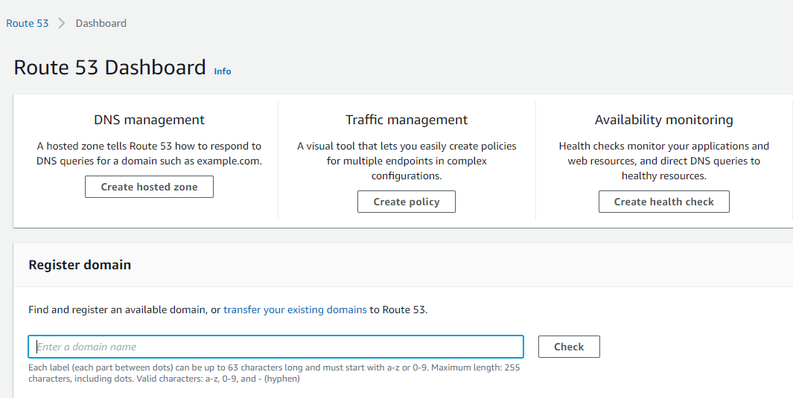
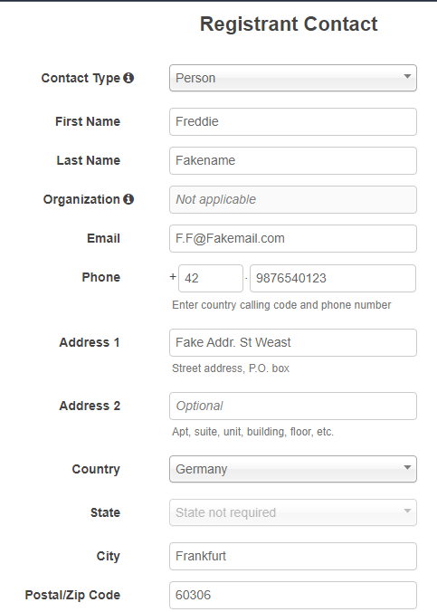
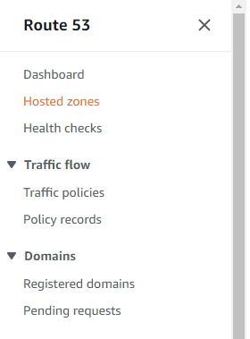
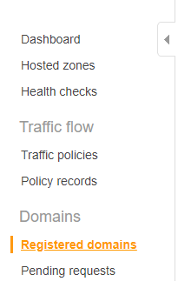
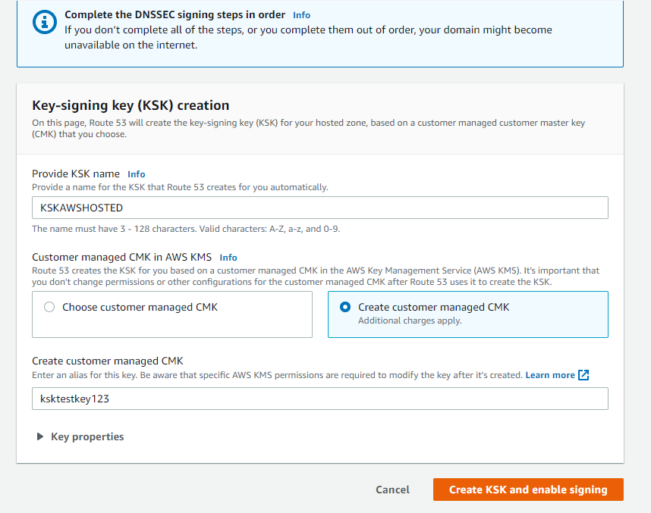
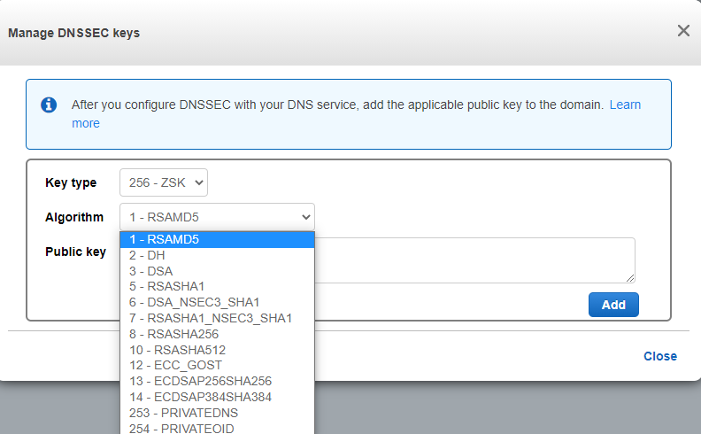
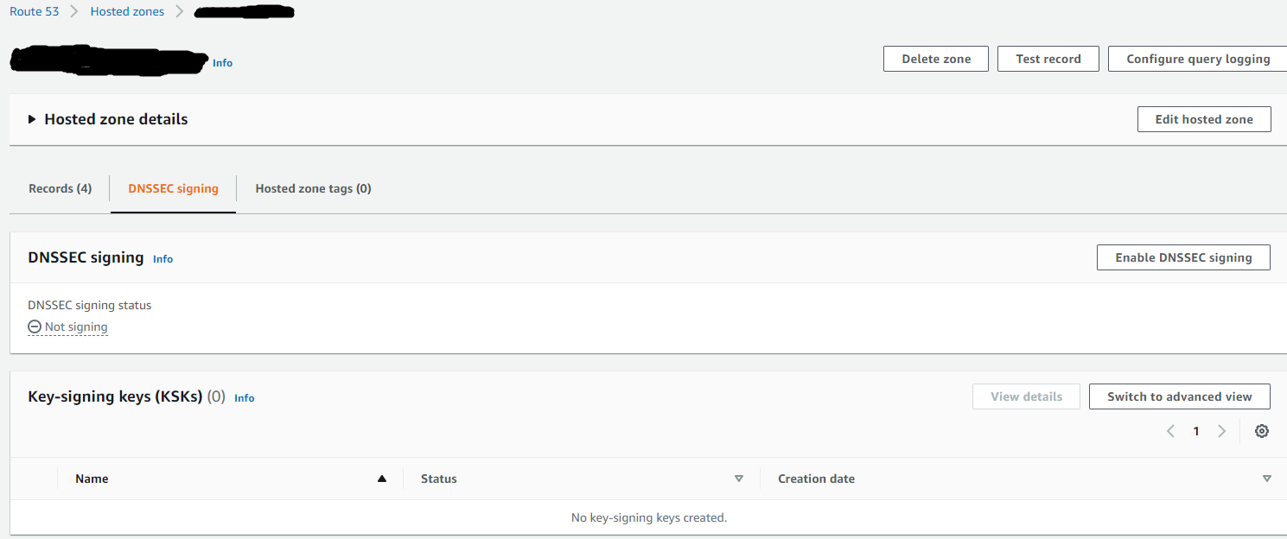
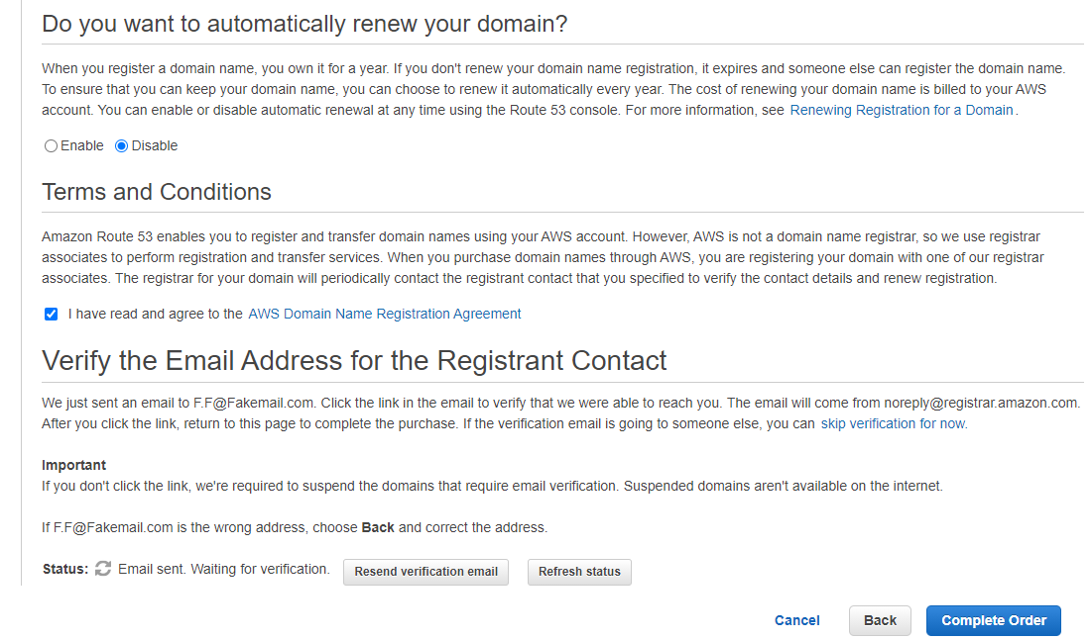
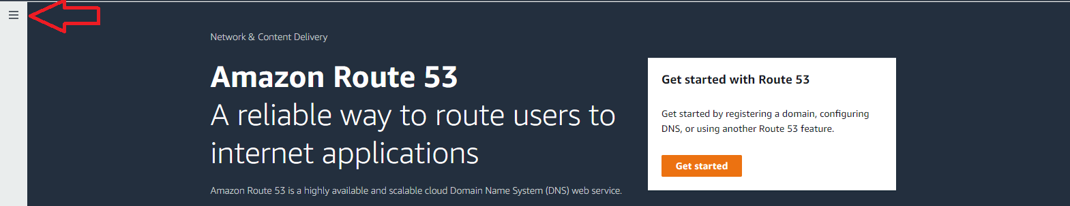
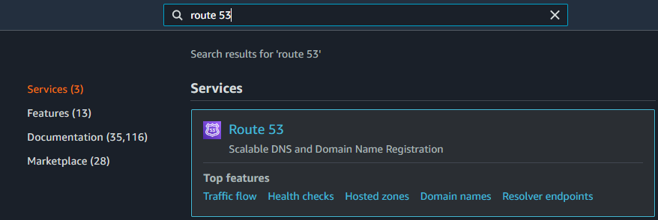
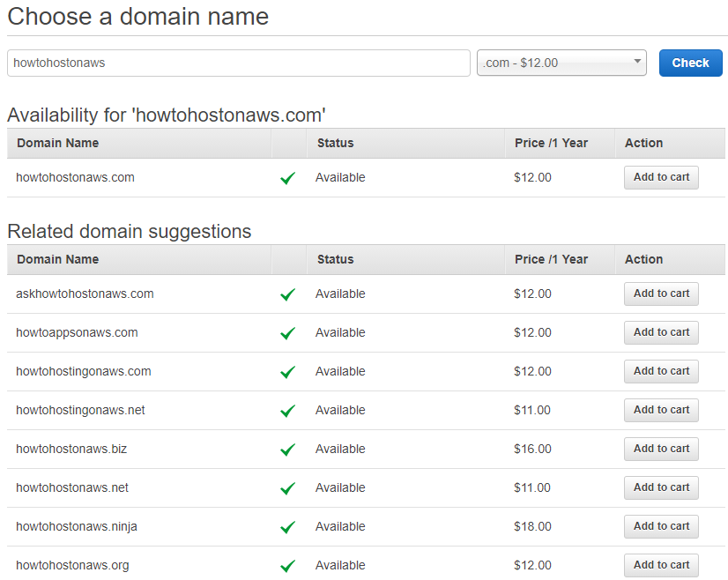
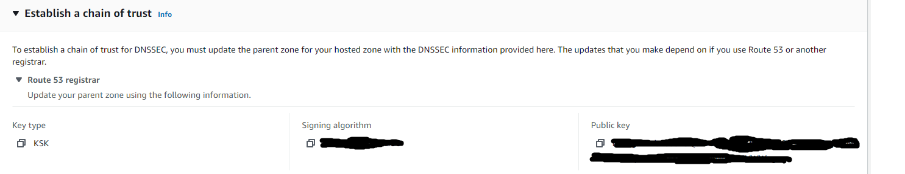
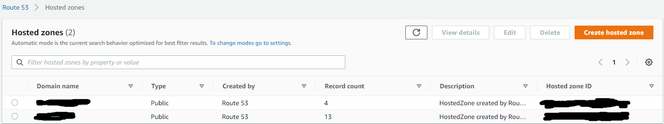
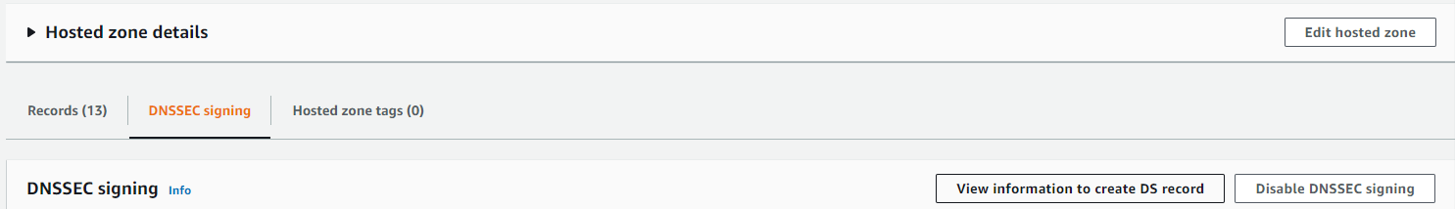
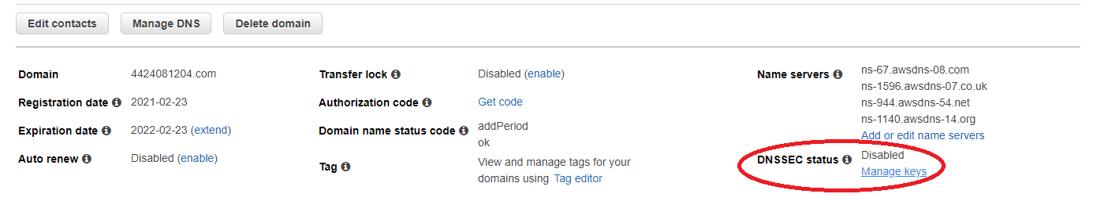
Route 53
Amazon’s DNS service
Navigate to the Register Domain section of Route 53 and choose an available name
Fill out contact information
Navigate back to Route 53
Enable DNSSEC

Slide 3
S3 (Simple Storage Service)
One of Amazon’s cloud-based object storage solutions, a basic flat but scalable filesystem
Navigate to S3 and create a bucket
Allow public access
Enable static website hosting and keep note of new website endpoint
Build your React project and upload the build folder
Attach JSON policy to bucket

Slide 4
Pairing S3 with Route 53 and CloudFront
Navigate back to Route 53’s hosted zones
Switch to wizard view and select simple routing
Add an alias to your S3 endpoint you noted earlier
Create a CloudFront distribution using your S3 endpoint as the origin domain name, and your registered domain as an alternate domain name
Select “Redirect HTTP to HTTPS” and get an SSL certificate from Amazon ACM
Navigate back to your Route 53 hosted zone, and change your alias pointing to S3 to point to CloudFront instead

Slide 5
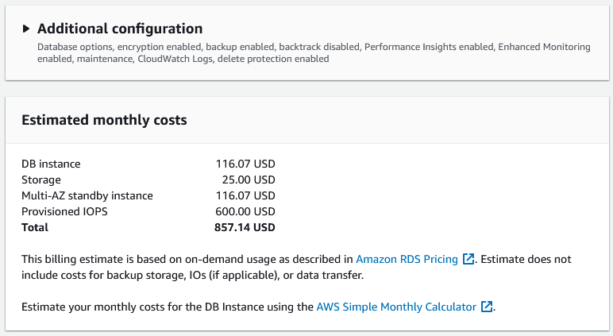



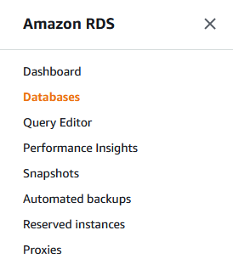

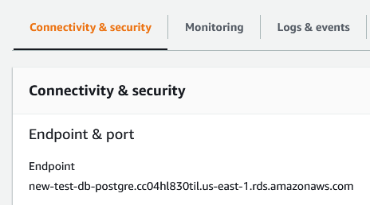
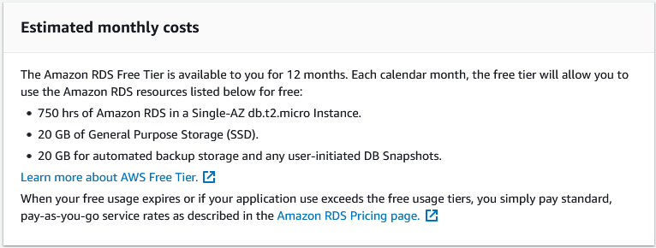
Backend Options
Amazon S3 provides simple, scalable object storage
S3 Infrequent Access
S3 Glacier
Amazon RDS gives us multiple database hosting options
Navigate to RDS
Configure and create database
Note the endpoint for the newly created database
Code execution options
Amazon EC2
AWS Lambda
Amazon RDS
Amazon S3
Amazon Lambda
Amazon EC2

Slide 6
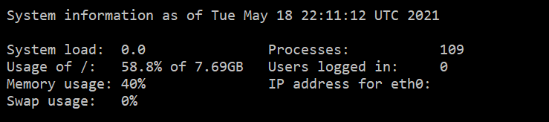
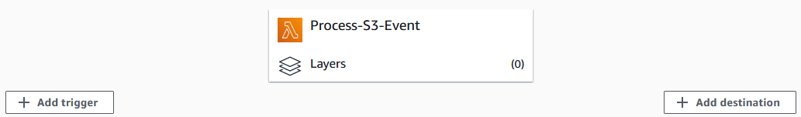
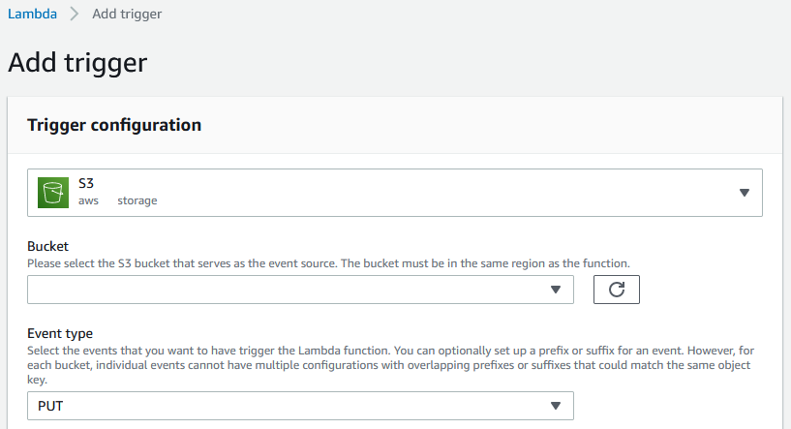
EC2 and Lambda
EC2 is a persistent virtual environment
More setup and maintenance
Better suited for constant or high-load processing
Lambda is event-driven code execution
Lightweight
Executes the code you want off the trigger of a specific event
Flexible

